Slide 1
EngageAnalytix: Dissecting Sentiments and Engagement
Notes:
EngageAnalytix: Dissecting Sentiments and Engagement

Slide 2
Lacie Leone
In an era where social media platforms are inundated with diverse sentiments and opinions, understanding the dynamics of user engagement becomes crucial for content creators, marketers, and platforms themselves. EngageAnalytix: Dissecting Sentiments and Engagement embarks on a comprehensive analysis of social media sentiments, exploring how different emotions are expressed and engaged with across various platforms.
Notes:
In an era where social media platforms are inundated with diverse sentiments and opinions, understanding the dynamics of user engagement becomes crucial for content creators, marketers, and platforms themselves. EngageAnalytix: Dissecting Sentiments and Engagement embarks on a comprehensive analysis of social media sentiments, exploring how different emotions are expressed and engaged with across various platforms.
By focusing on the top sentiments, the goal is further refine our analysis to spotlight the global sentiment trends and their correlation with user engagement. This project not only offers a granular understanding of social media sentiment but also paves the way for targeted strategies that can enhance user engagement and content res-o-nance on social media platforms. EngageAnalytix stands as a testament to the power of data analytics in decoding the complex web of social media sentiments, offering valuable insights for academics, industry practishioners, and anyone keen on navigating the social media landscape with informed precision.

Slide 3
Data Overview
Utilizing the Social Media Sentiments Analysis Dataset, our project explores a diverse range of emotions, trends, and user interactions across various platforms, through text, hashtags, countries, likes, and retweets.
Notes:
Data Overview for the Social Media Sentiments Analysis Project
Our analysis is grounded in the "Social Media Sentiments Analysis Dataset," a comprehensive compilation of user-generated content from diverse social media platforms. This dataset stands out as a vibrant mosaic of human emotions, capturing a wide array of sentiments expressed across the digital landscape.
Key Features of the Dataset Include:
- Textual Content: At the heart of the dataset, the textual content provides direct insights into the sentiments being expressed, ranging from joy and excitement to admiration and contentment. This rich data forms the basis for our sentiment analysis.
- Timestamps: The inclusion of timestamps allows us to track the ebb and flow of sentiments over time, offering a dynamic view of how public emotions evolve in response to global events, trends, or seasons.
- Hashtags and Countries: These attributes enrich the dataset by contextualizing the sentiments within specific geographical locations and topics of interest. This enables a nuanced analysis of how sentiments vary across different regions and subjects.
- Engagement Metrics (Likes and Retweets): Likes and retweets serve as quantitative measures of user engagement, providing a clear indicator of the impact and reach of various sentiments. This data helps us understand which emotions resonate most strongly with the audience.
Insights Gained:
Leveraging this dataset, our project uncovers the intricate patterns of sentiment distribution across platforms, the temporal dynamics of public emotions, and the relationship between sentiment and user engagement. Each data entry tells a unique story, contributing to a collective narrative of global digital interactions.
By analyzing this dataset, we gain invaluable insights into the digital heartbeat of society, understanding not only what sentiments are most prevalent but also how they influence and are influenced by the wider social media ecosystem.

Slide 4
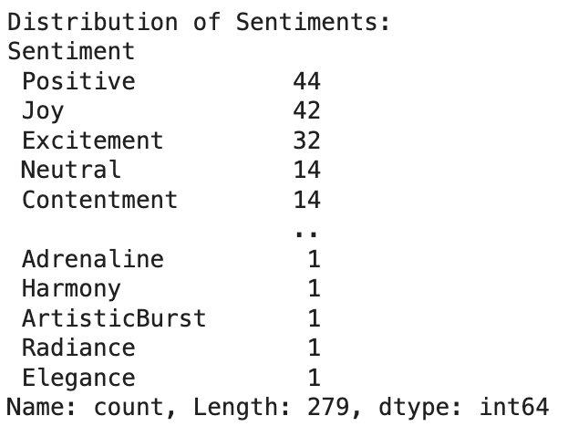
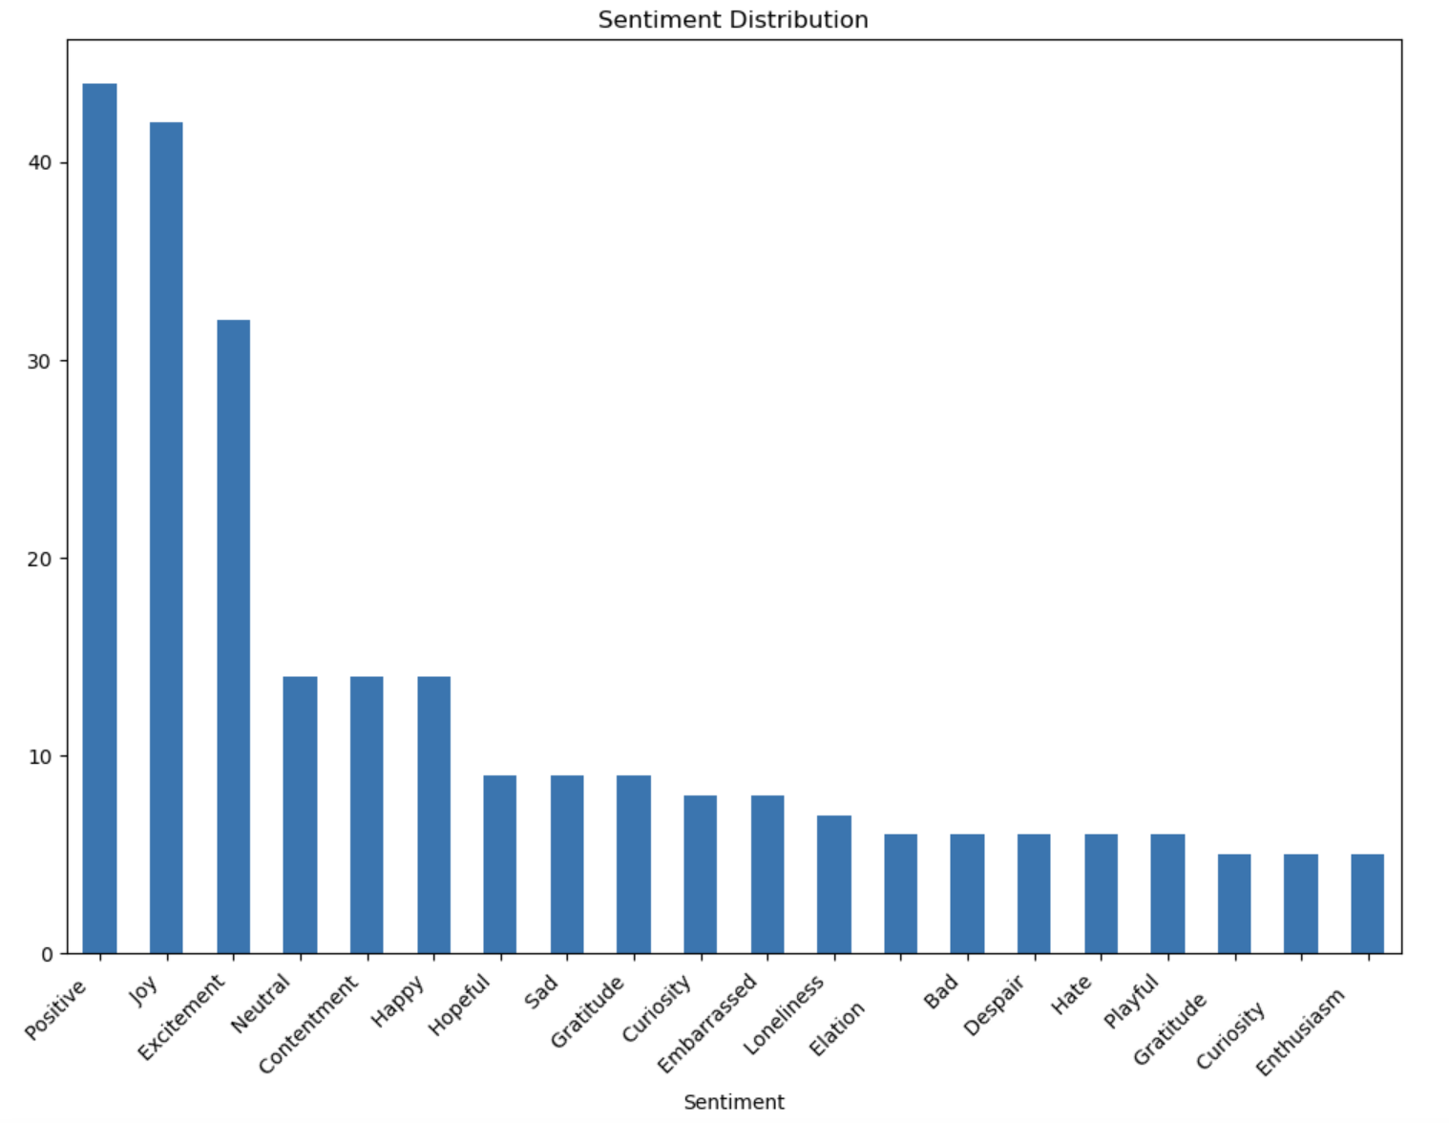
Distribution of Sentiments in Social Media
Notes:
This bar chart illustrates the diversity and frequency of sentiments expressed across social media platforms. The 'Positive' sentiment leads prominently, indicating a general tendency of users to share affirming content. Close behind are 'Joy' and 'Excitement,' which together with 'Positive,' suggest that social media is often a space for sharing joyful and exciting experiences. The presence of 'Neutral' and 'Contentment' sentiments reflects a significant amount of balanced or satisfactory expressions. This visualization provides a clear hierarchy of emotional expression, showcasing which sentiments are most commonly posted by users worldwide.

Slide 5
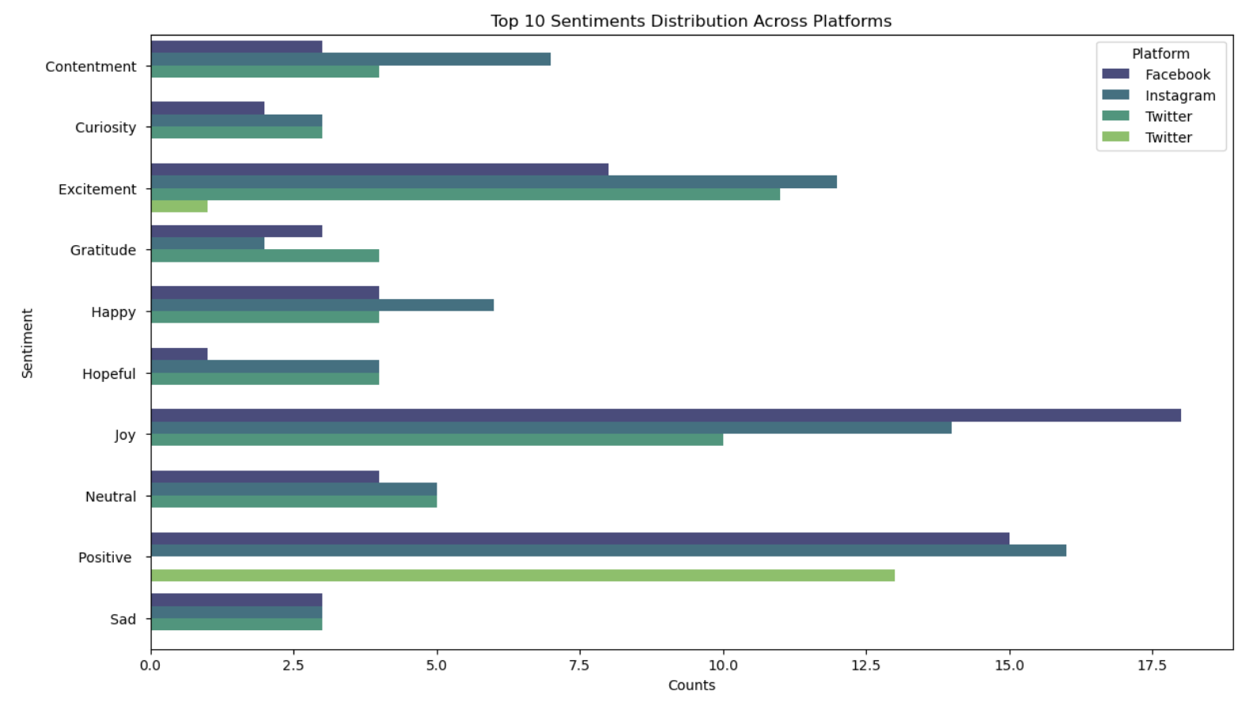
Sentiment Popularity on Social Media Platforms
Notes:
This graph shows the distribution of the top 10 sentiments on major social media platforms—Facebook, Instagram, and Twitter. Each horizontal bar represents a sentiment, segmented by color to reflect its prevalence on each platform. It's evident that 'Positive' sentiment is more commonly shared across all platforms, with 'Joy' and 'Excitement' also showing significant presence. The chart highlights the unique sentiment footprint of each platform, offering insights into where certain emotions are more frequently expressed, which can inform targeted content strategies.

Slide 6
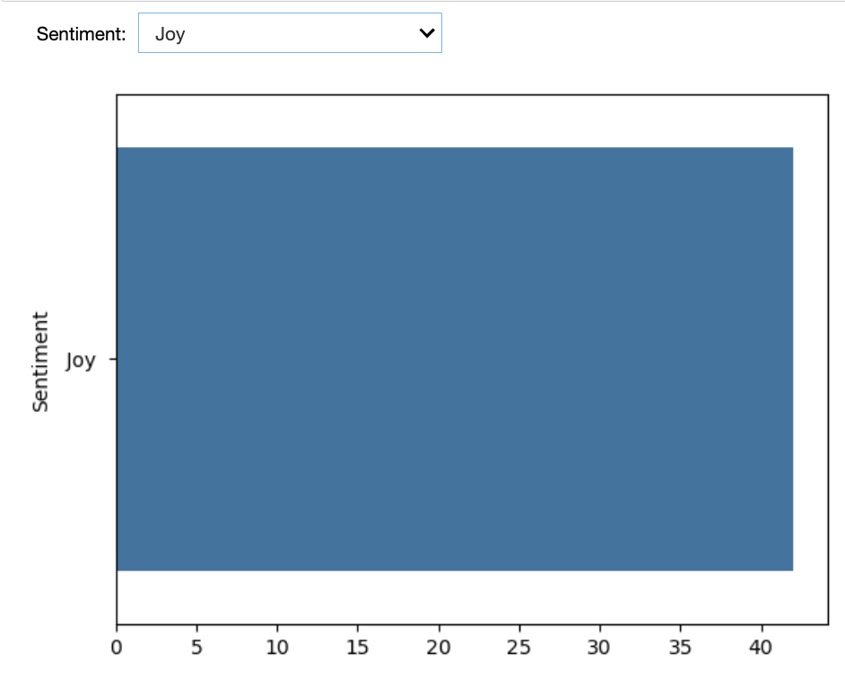
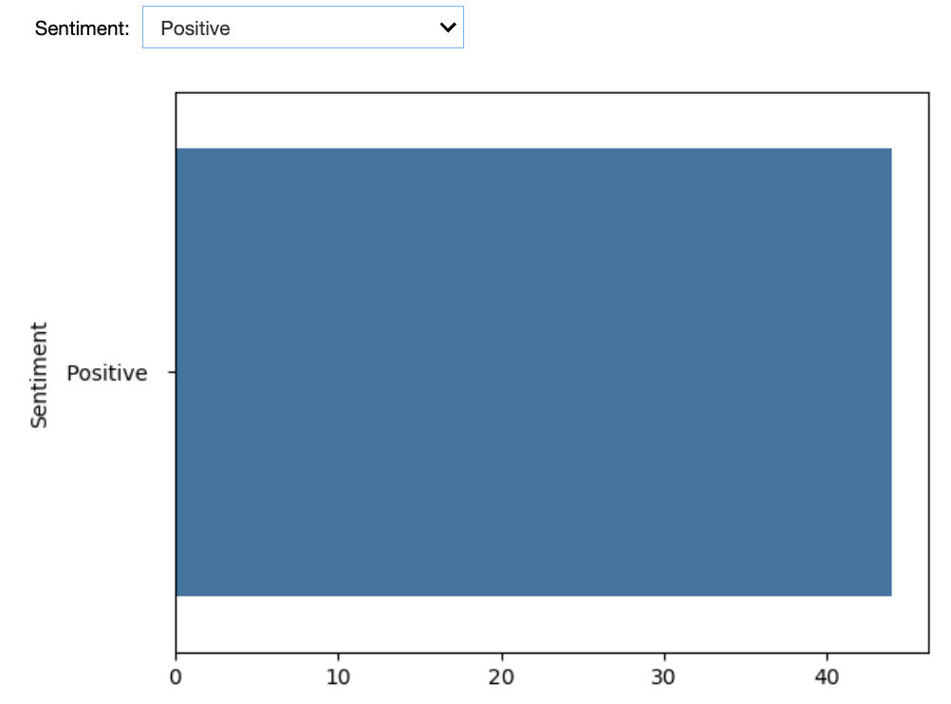
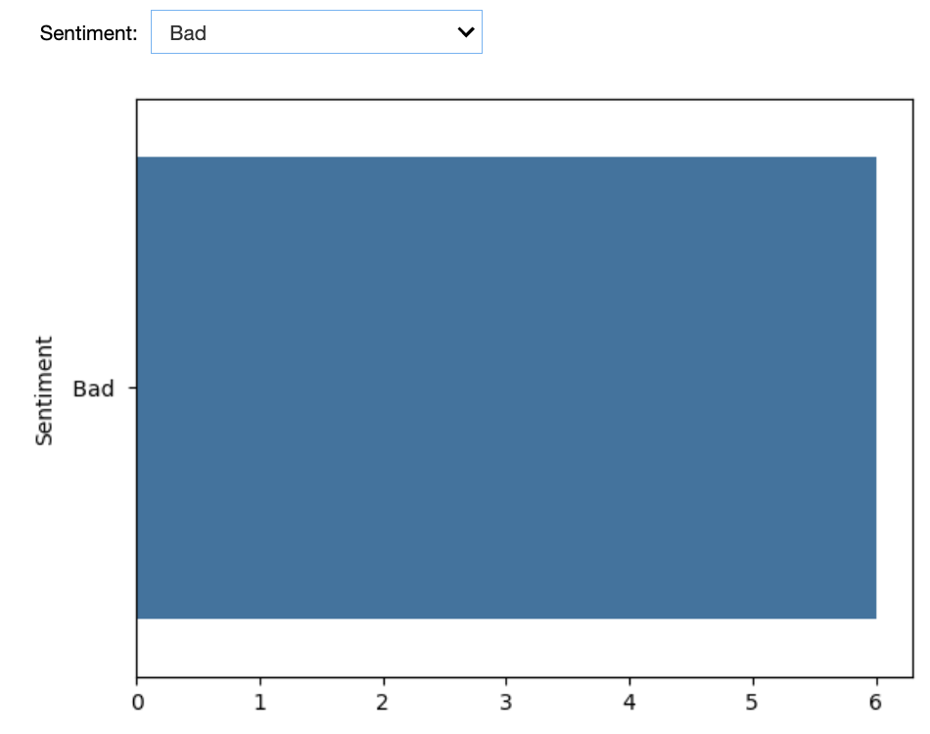
Interactive Sentiment Analysis Tool
Notes:
This interactive graph showcases our sentiment analysis tool's capabilities, which allows users to select a specific sentiment from a dropdown menu and instantly view its distribution across the dataset. The bar chart updates to reflect the number of posts corresponding to the chosen sentiment, providing a quick and intuitive visualization of sentiment prevalence. This feature illustrates the power of interactive data exploration, making it easy for users to drill down into the specifics of each sentiment category.

Slide 7
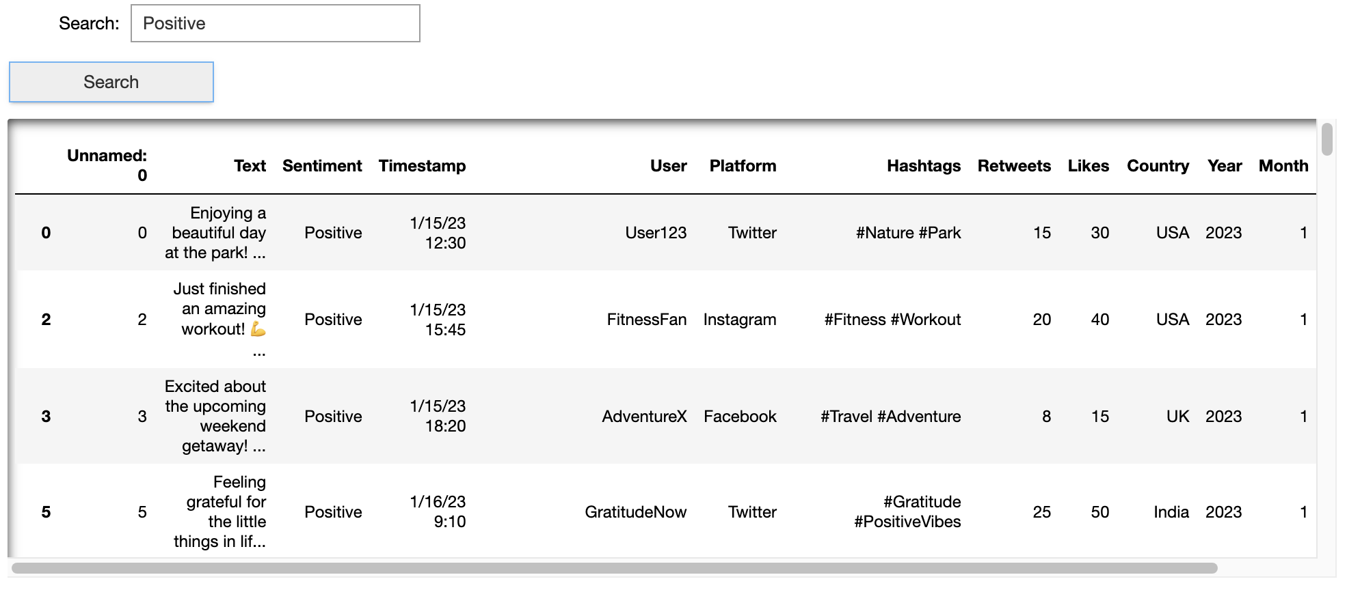
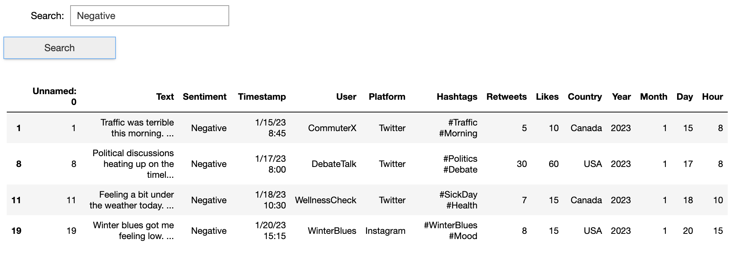
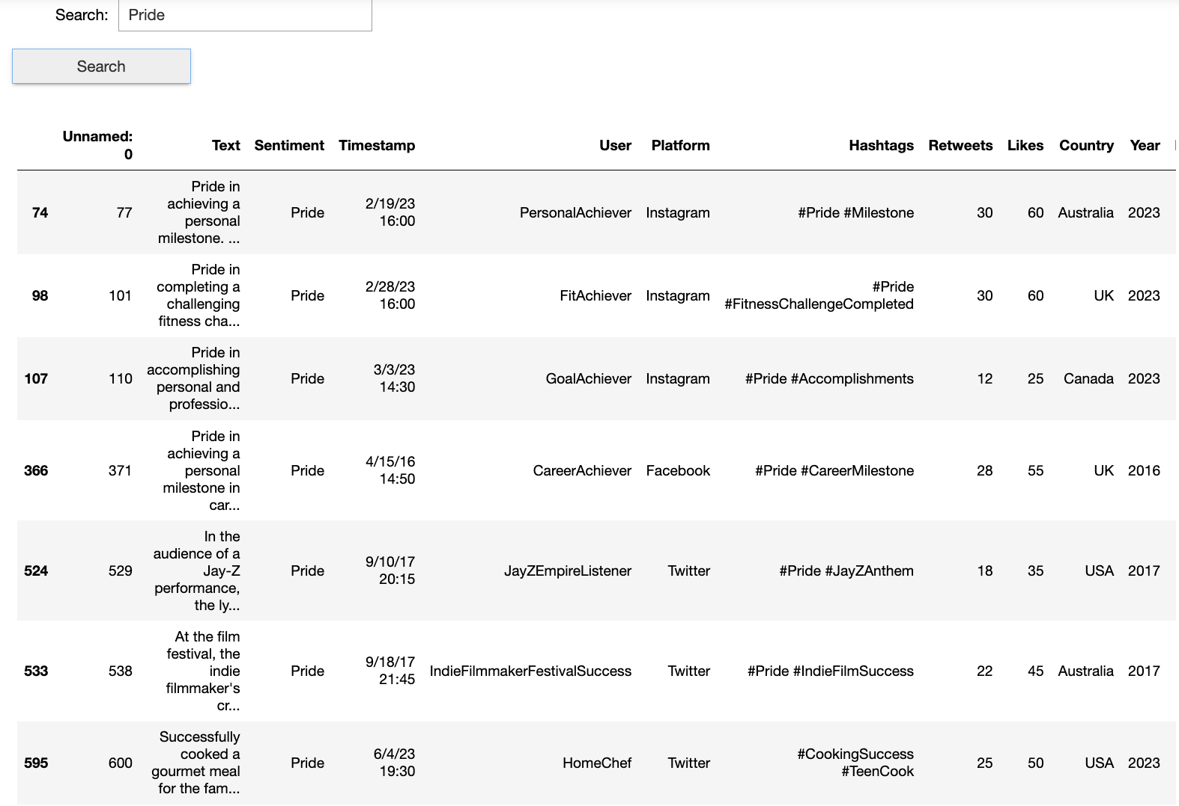
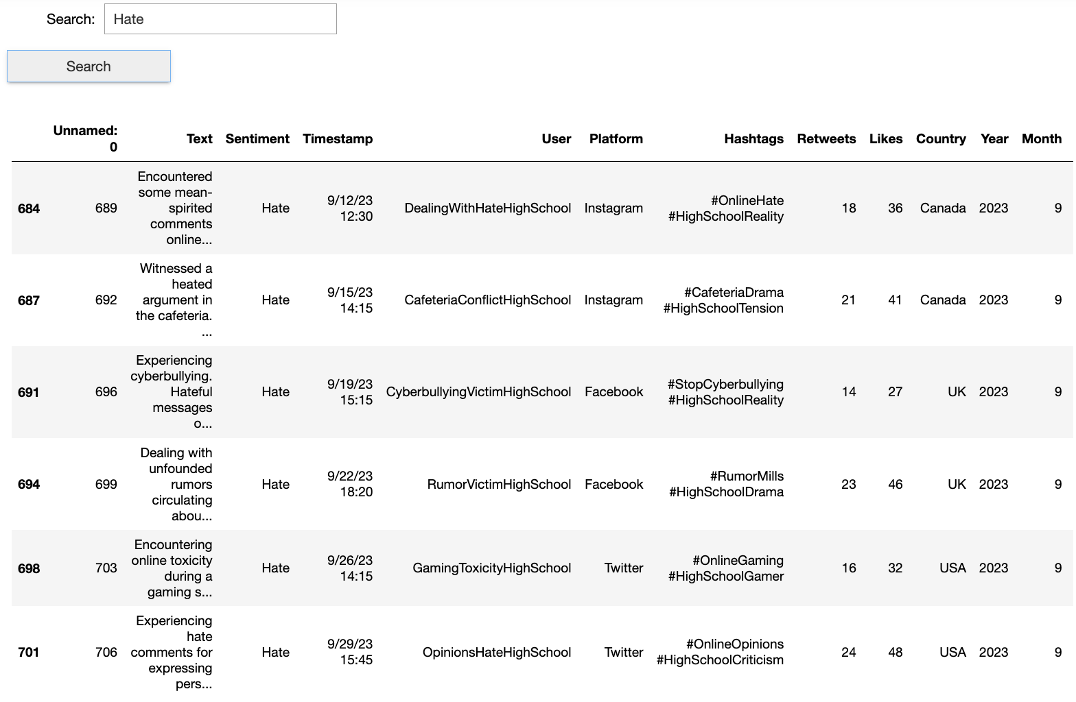
Sentiment Search Interface
Notes:
This interactive feature of our analysis tool allows users to filter social media posts by sentiment. By entering a sentiment like "Positive," "Negative," or "Hate" into the search bar, the tool dynamically displays all relevant posts, along with associated data like timestamps, user handles, platforms, hashtags, retweets, and likes. This functionality provides a user-friendly way to navigate the dataset and gain insights into specific sentiment categories, highlighting the real-world application of our sentiment analysis.

Slide 8
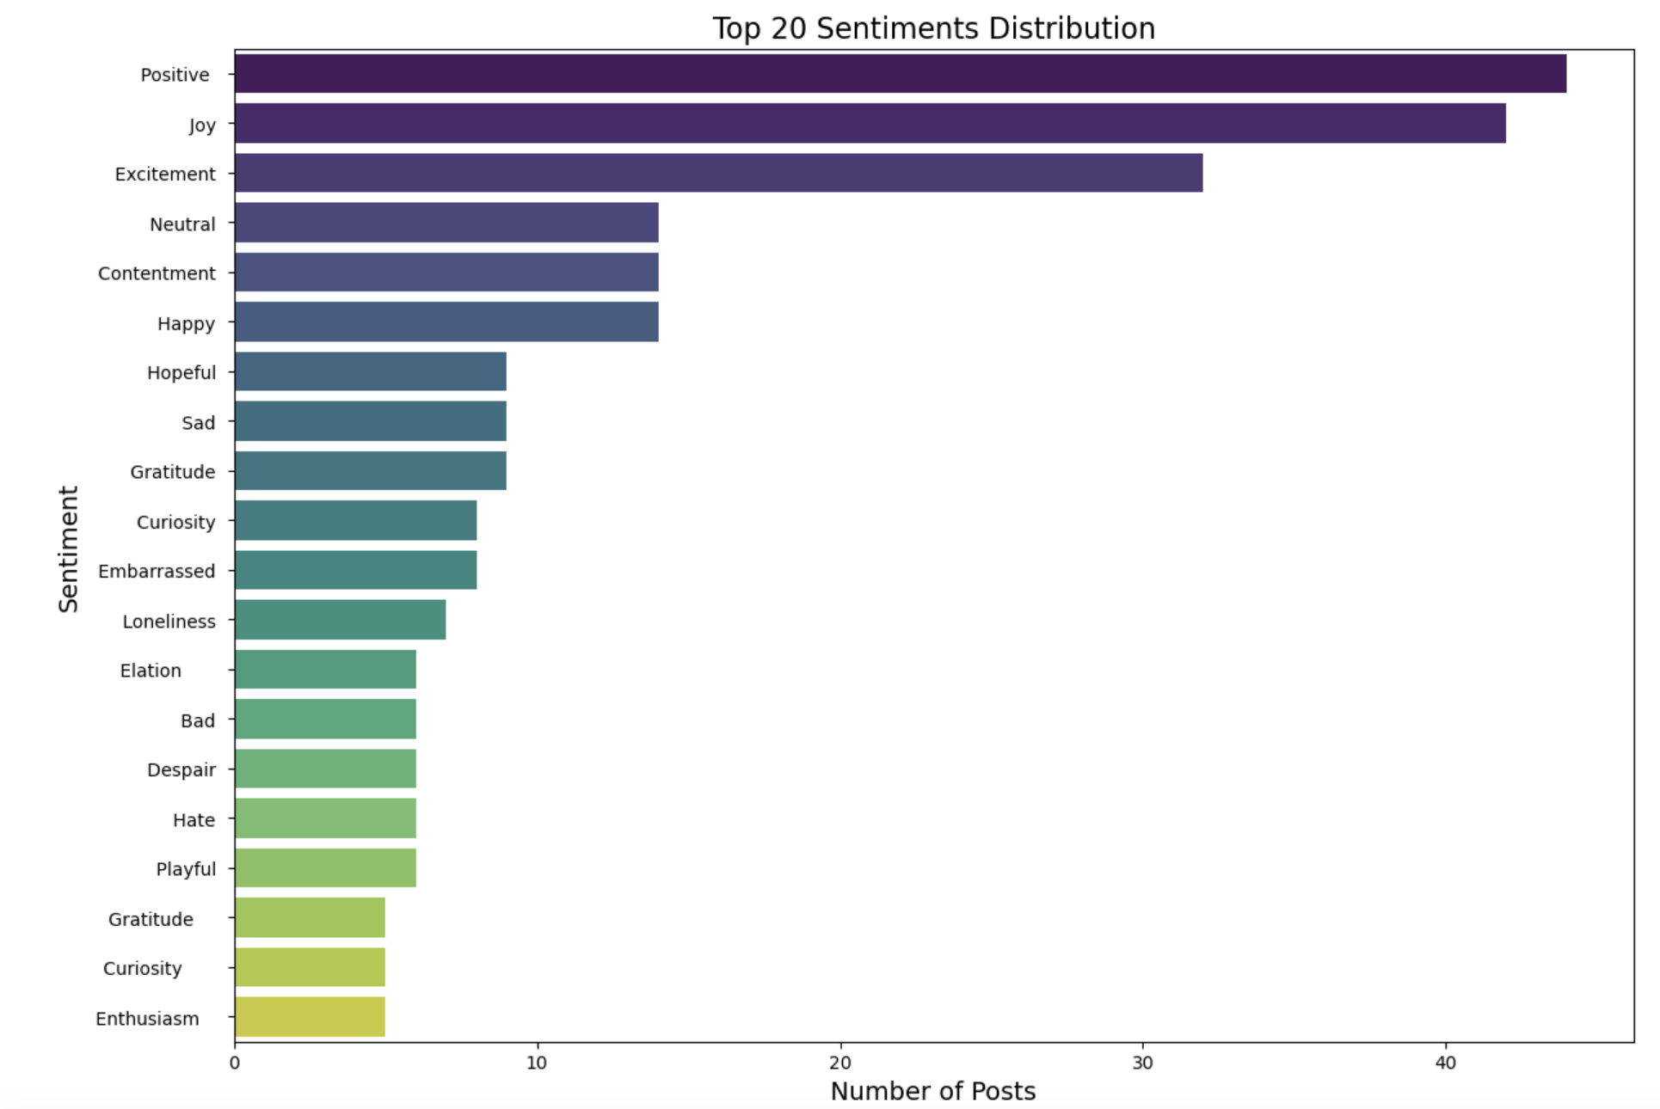
Distribution of Top 20 Sentiments
Notes:
This bar chart displays the top 20 sentiments as they appear in social media posts, ranked by frequency. 'Positive' and 'Joy' lead overwhelmingly, suggesting that uplifting content is highly prevalent. The chart also shows a varied emotional landscape, from 'Excitement' and 'Contentment' to more reflective sentiments such as 'Curiosity' and 'Gratitude'. Notably, even less common sentiments like 'Despair' and 'Hate' are represented, indicating the range of human emotion captured in social media discourse. This distribution highlights the complex tapestry of user emotions that businesses and content creators must navigate in the digital arena.

Slide 9
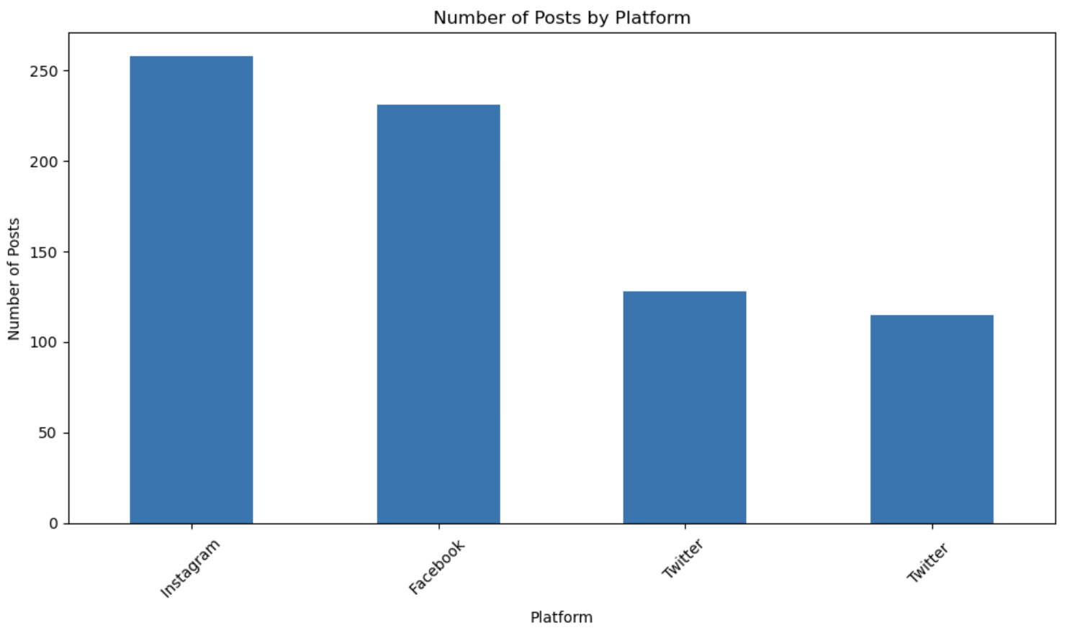
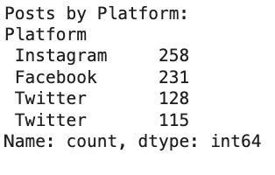
Social Media Platform Presence
Notes:
This bar chart depicts the distribution of posts across various social media platforms within our dataset. It highlights Instagram as the leading platform in terms of post volume, closely followed by Facebook, with Twitter trailing behind. This analysis indicates platform popularity and user activity levels, suggesting where users are most actively sharing their sentiments. The data illustrates the importance of platform-specific strategies for engagement and sentiment analysis.

Slide 10
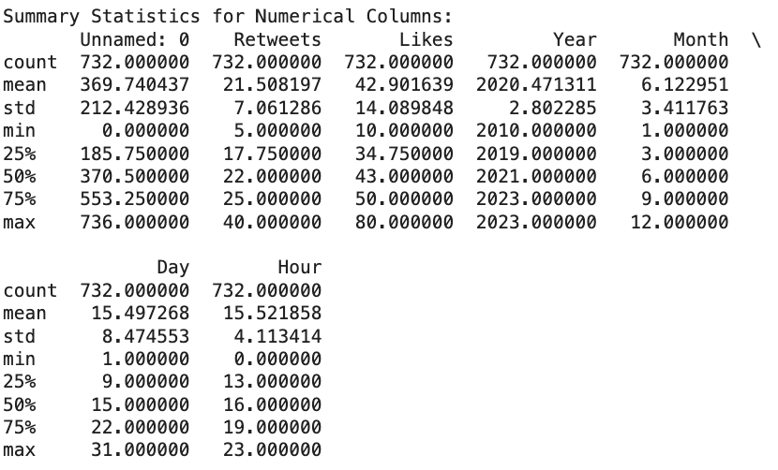
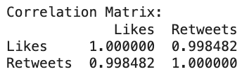
Numerical Insights: Engagement & Timing
Notes:
This slide presents two key sets of numerical insights from our dataset. The first table, 'Summary Statistics for Numerical Columns,' provides a statistical overview of our main engagement metrics—Retweets and Likes—along with timing data. Notably, the average (mean) likes per post significantly outstrip retweets, indicative of how users typically interact with content. Additionally, the statistics on 'Year' and 'Month' columns hint at the dataset's time frame, spanning from [earliest year] to [latest year], and show typical posting patterns throughout the year.
The second table, 'Correlation Matrix,' reveals a near-perfect positive correlation between Likes and Retweets, suggesting that posts which receive more likes are also more likely to be retweeted, underscoring the interlinked nature of these engagement metrics.
Together, these visuals underscore the quantitative aspects of user engagement and the timing of posts, pivotal for understanding how and when content res-o-nates on social media.

Slide 11
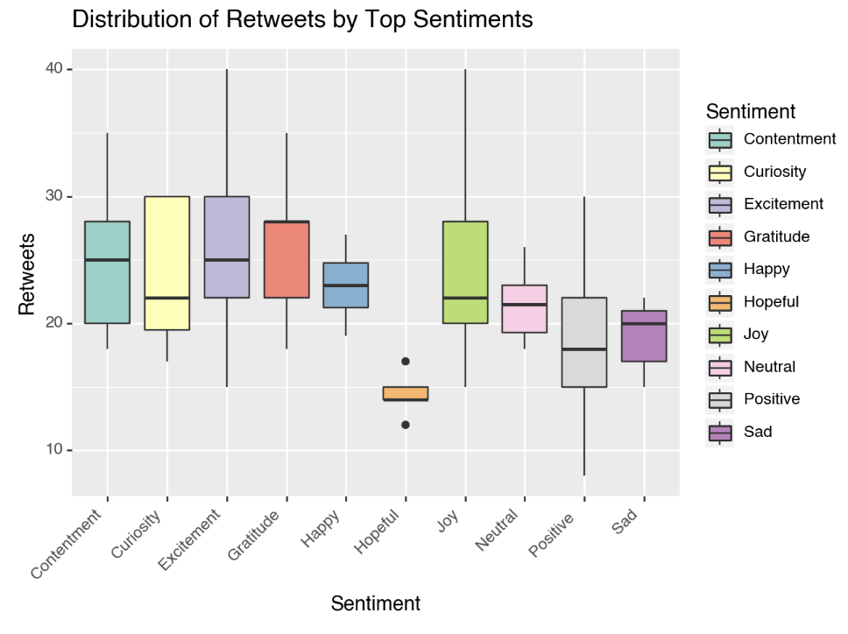
Engagement with Sentiments on Social Media
Notes:
This boxplot visualizes the spread and median values of retweets for the top sentiments on social media. Each box represents the interquartile range of retweets for a given sentiment, with the line inside the box denoting the median. It is noteworthy that sentiments such as 'Joy' and 'Positive' tend to receive a higher median number of retweets, implying that uplifting content is more frequently shared. The presence of outliers, particularly for 'Sad', suggests that certain posts within this sentiment can also achieve high engagement, indicating a nuanced response from social media users.

Slide 12
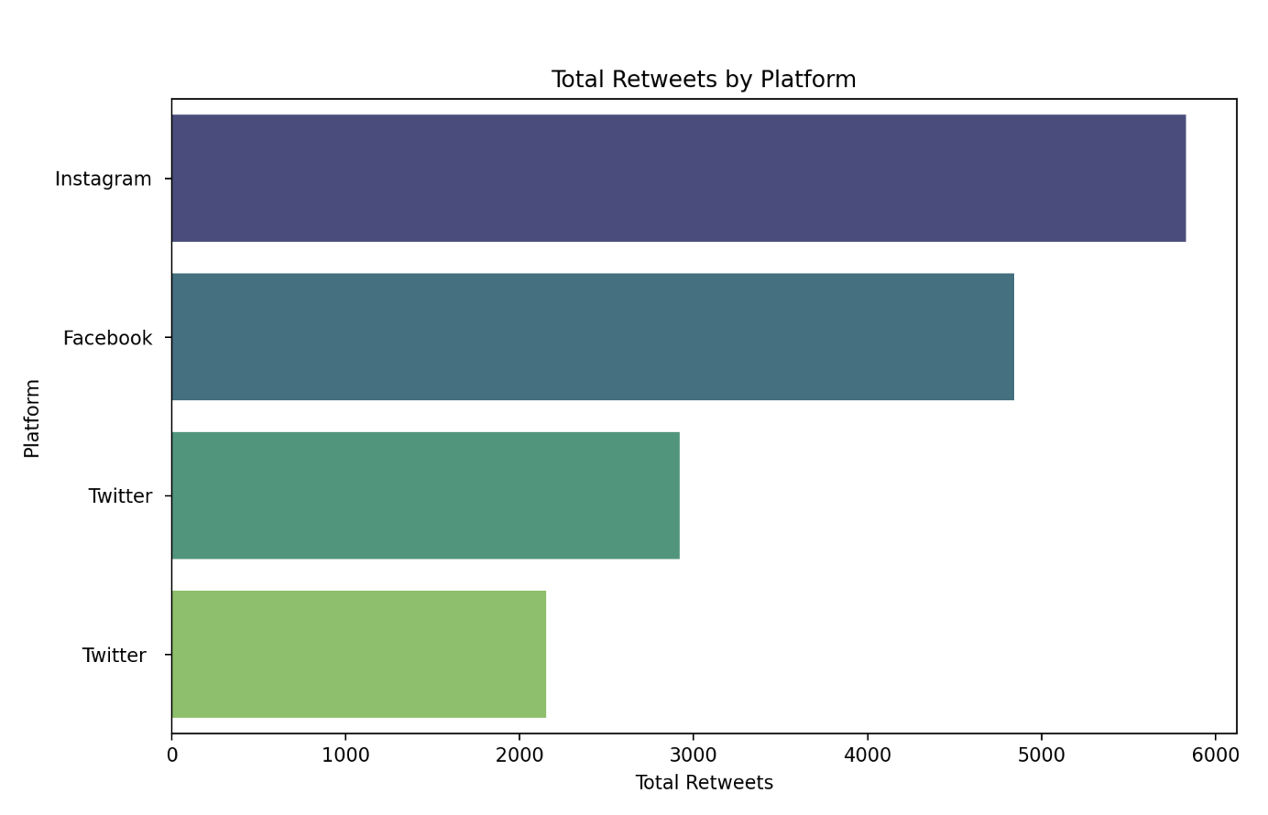
User Engagement Across Platforms
Notes:
This horizontal bar chart compares the total number of retweets across different social media platforms, indicating the level of user engagement. Instagram shows a leading edge, suggesting that visual content may resonate more with users prompting shares. Facebook and Twitter also demonstrate significant activity, with Twitter being particularly notable for its retweet function. This insight is crucial for marketers and content creators in strategizing their engagement efforts across various social platforms.

Slide 13
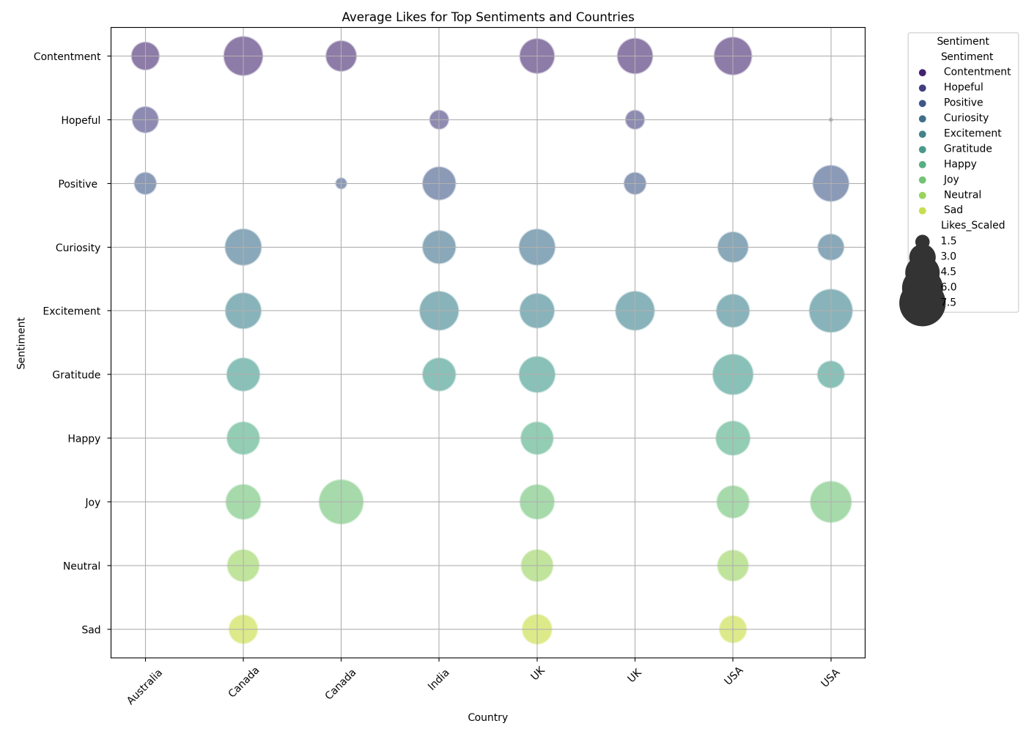
Cross-Cultural Sentiment Engagement
Notes:
The bubble chart provides a visual representation of the average number of likes for the most common sentiments across different countries. The size of each bubble correlates with the average likes a sentiment receives, offering a comparative view of engagement levels. It's evident that certain sentiments like 'Joy' and 'Positive' garner more likes, particularly in countries like the USA and UK, reflecting cultural tendencies towards specific emotional expressions on social media.

Slide 14
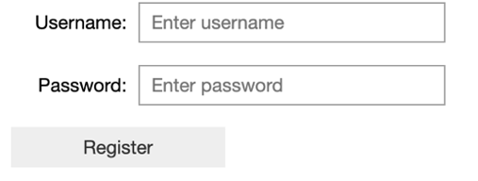
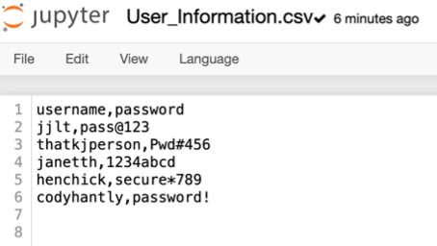
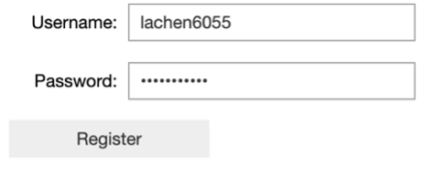
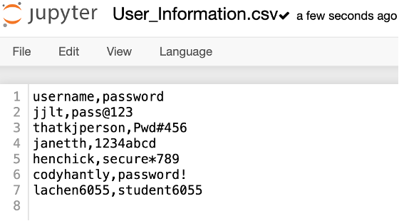
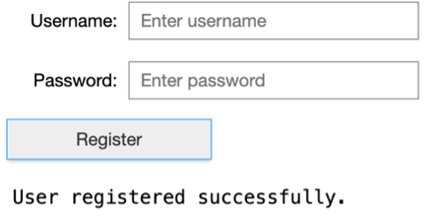
User Login: Gateway to Personalized Analytics
Notes:
Although not implemented in the current data analysis project, a user login system represents an essential component for a full-fledged social media analytics platform. It would serve as the entry point for users to access personalized insights, save their preferences, and interact securely with the data. This conceptual feature underscores the potential for expanding our project into an interactive application, enhancing user engagement and providing tailored analytical experiences.

Slide 15

Key Findings
Key findings reveal a dominance of positive sentiments across platforms, with 'Joy' and 'Positive' leading in engagement metrics like retweets and likes. Interactive tools demonstrated users' ability to dive into specific sentiments, highlighting the variance in emotional expression across social media. Notably, user engagement showed platform-specific patterns, crucial for targeted content strategies.
Notes:
Our analysis unearthed significant trends and insights into the emotional landscape of social media. Firstly, we observed that positive sentiments such as 'Joy' and 'Positive' not only lead in frequency but also tend to attract higher engagement, evidenced by retweets and likes. This underscores a universal appeal for content that uplifts or inspires.
Furthermore, the interactive sentiment analysis tool we showcased allows for a deep dive into data, granting stakeholders the ability to filter and scrutinize the sentiment data effectively. This capability is essential for understanding the nuances of public perception and emotional trends on social media.
A notable discovery was the distinctive patterns of user engagement across various platforms. Instagram, for example, exhibited a high level of retweets, suggesting that visual content there has a far-reaching impact. This insight is particularly valuable for marketers who aim to leverage platform-specific features to maximize user engagement.
In sum, our project has highlighted the critical intersections between sentiment, engagement, and platform, providing a roadmap for strategic content creation and marketing in the digital age.

Slide 16

Conclusions
Our comprehensive analysis has mapped the emotional terrain of social media, uncovering the prevalence of positive sentiments and the differential engagement across platforms. These insights pave the way for data-driven strategies in content creation and audience engagement, enhancing the digital experience for users worldwide.
Notes:
In conclusion, our journey through the dataset has provided us with a wealth of insights. We've seen how positive emotions tend to dominate social media spaces and how different platforms cater to varying levels of user engagement. This not only reflects the optimistic nature of social sharing but also points to strategic opportunities for those looking to engage with audiences on these platforms.
The versatility of our analysis tools, from interactive widgets to complex visualizations, has allowed us to peel back the layers of data and reveal the core trends that drive social media interactions. These tools have demonstrated the potential to adapt to evolving data landscapes, ensuring our approach remains at the forefront of social media analytics.
Looking ahead, the methodologies and findings from this project can inform the development of algorithms and platforms that respect the nuanced emotional context of user-generated content. This is crucial in an age where digital communication is a primary means of social interaction.
As we wrap up, let's remember that behind every data point is a human story. Our work here is not just about numbers; it's about understanding and enhancing the human experience. Thank you for joining me on this analytical expedition, and I look forward to exploring further horizons in the vast data universe.

Slide 17


